Slide 1
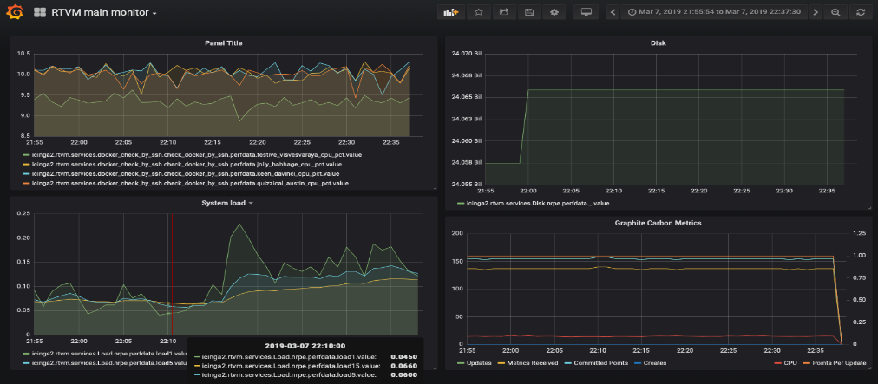
Design of orchestrator Implementation
Readout of kernel memory to monitor the status of threads
Tracing of performance parameters
Icinga2 monitoring system gathers system status
Container data is collected in a time series database (Graphite). Graphite is interfaced directly with Icinga through a plugin
Data is read and displayed in a web interface (Grafana, in picture)

Slide 2
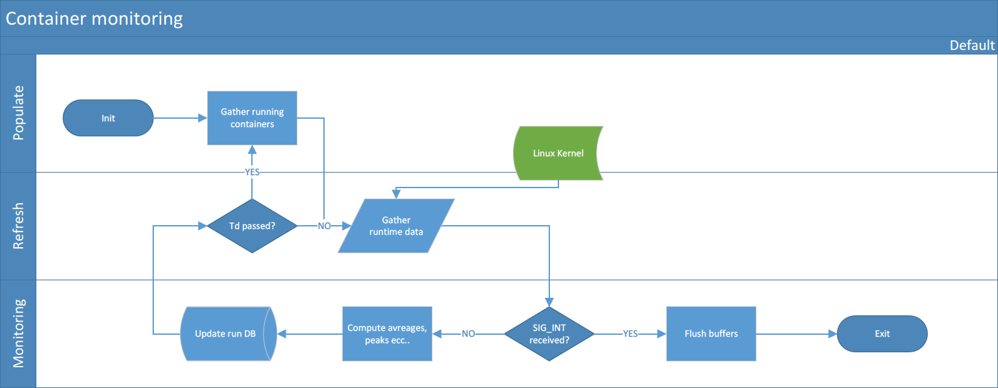
Monitoring of active containers
Keeps an updated list of the running containers
Acquires performance parameters
Maintains a history of the runtime values

Slide 3
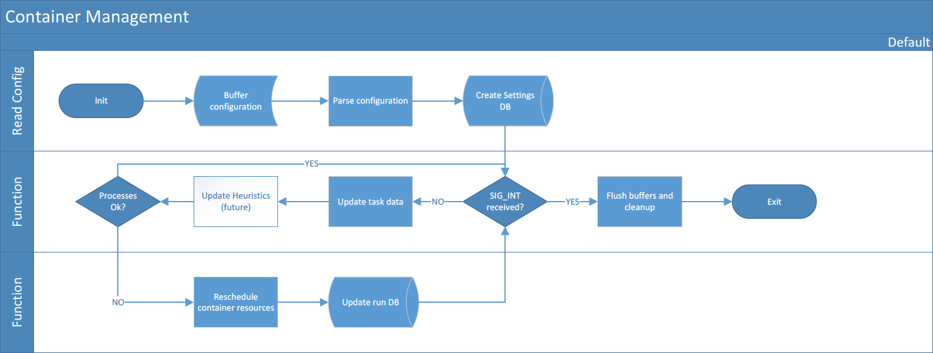
Managing of active containers
Reads and stores configuration as parameter memory
Based un runtime data, verifies operation limits
If exceeded, reorganizes task’s resource assignment

Slide 4
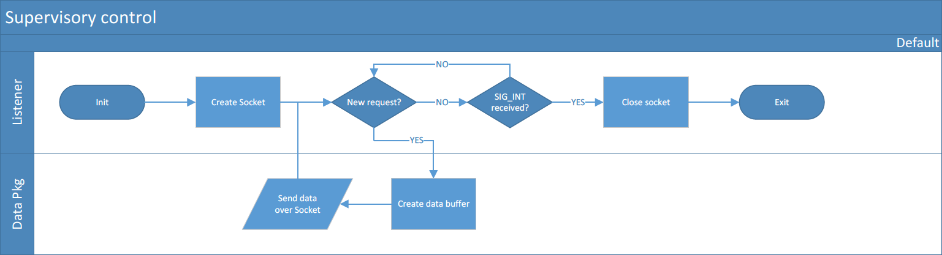
Report and tracing
Keeps connection with Icinga monitoring service
Updates the service with changes and issues
Responds to external input

